Slide 1
A technical report on Historical Sales of Supermarket Company in different cities Submitted by: Robin Roy – https://github.com/Iamrobinroy?

Slide 2

About the Dataset
Growth of supermarket company in different cities
The dataset holds the entries of historical sales of supermarkets.
The supermarket company has three branched named as A ,B and C and the data is collected from them
The period the data is collected is for three months duration.
“We use database management system (DBMS) to manage larger amount of data to meaningful conclusions.”

Slide 3
Objective
To analyze the total credits provided by the institution to various departments in different countries.
The goal of analyzing the IDA statement dataset is to get an idea about the development and factors for countries to request loans, such as
Stage of development.
Departments which requires more financial help.
A descriptive analysis of the credit status of a particular country has been carried out
.

Slide 4

Data Source
URL : https://www.kaggle.com/aungpyaeap/supermarket-sales/
Data Processing:
Data is organized in the following categories
Invoice ID
Branch
City
Customer
Gender
Product line
Unit Price
Quantity
Tax
Total Amount
Date
Time
Payment Mode

Slide 5
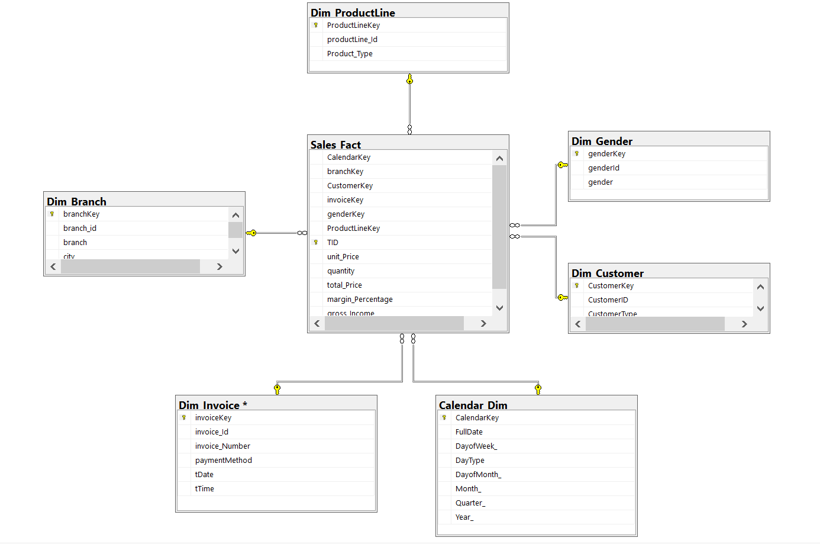
Star Schema

Slide 6
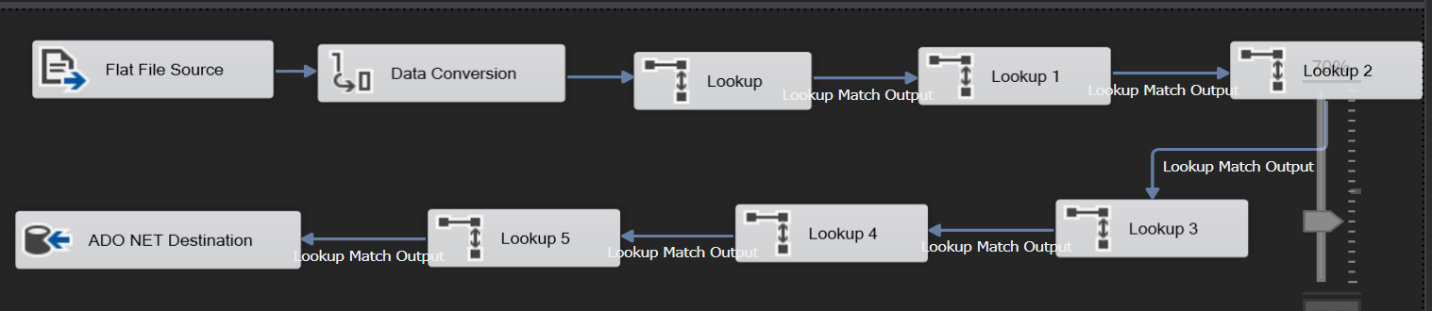
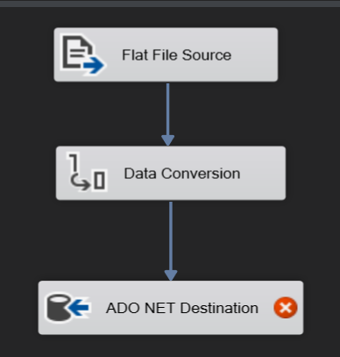
ETL Diagram : Extract-Transform-Load

Slide 7
Reports
Documents produced as result of data analysed.
Report with table comparison of prices in order to increase the sales and profit percentage.
The no. of products sold on particular date and also which gender buy more.
Product sold in and particular branch based on that we can able to analyze which product is sold more in which branch.
Details of each category of goods purchased

Slide 8
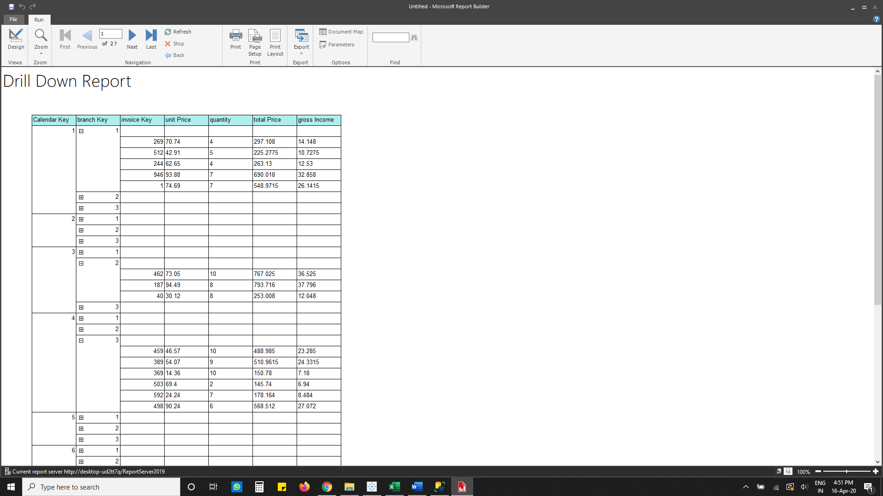
Drill down Report: Details of each category of goods purchased

Slide 9
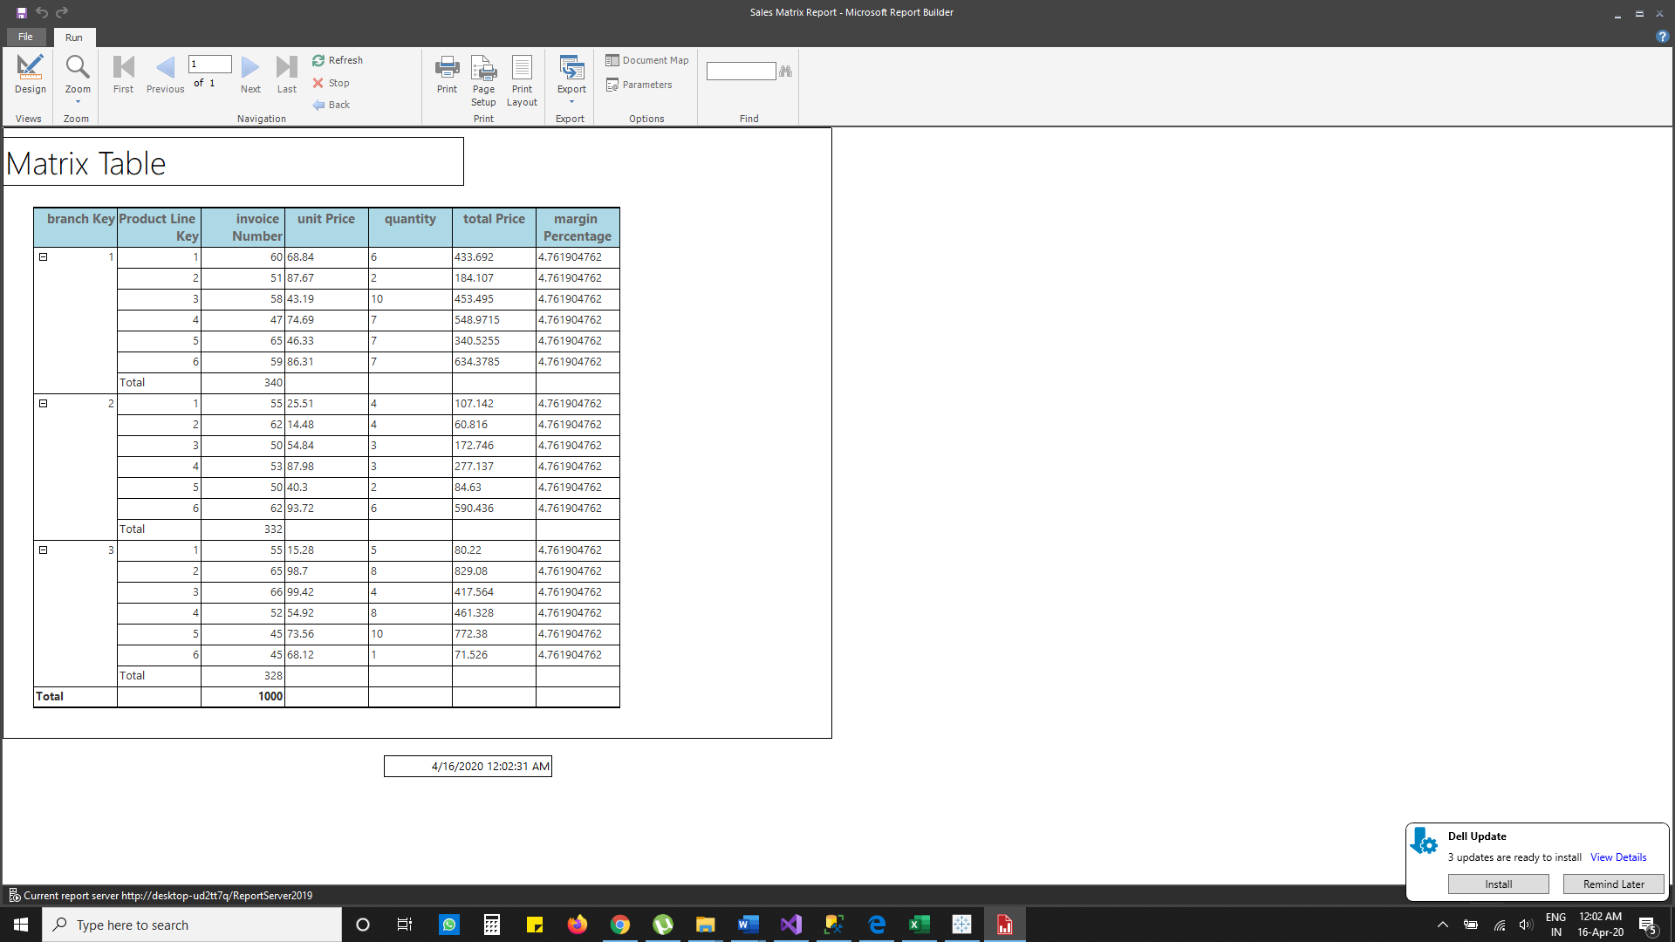
Matrix Report: Comparision of prices

Slide 10
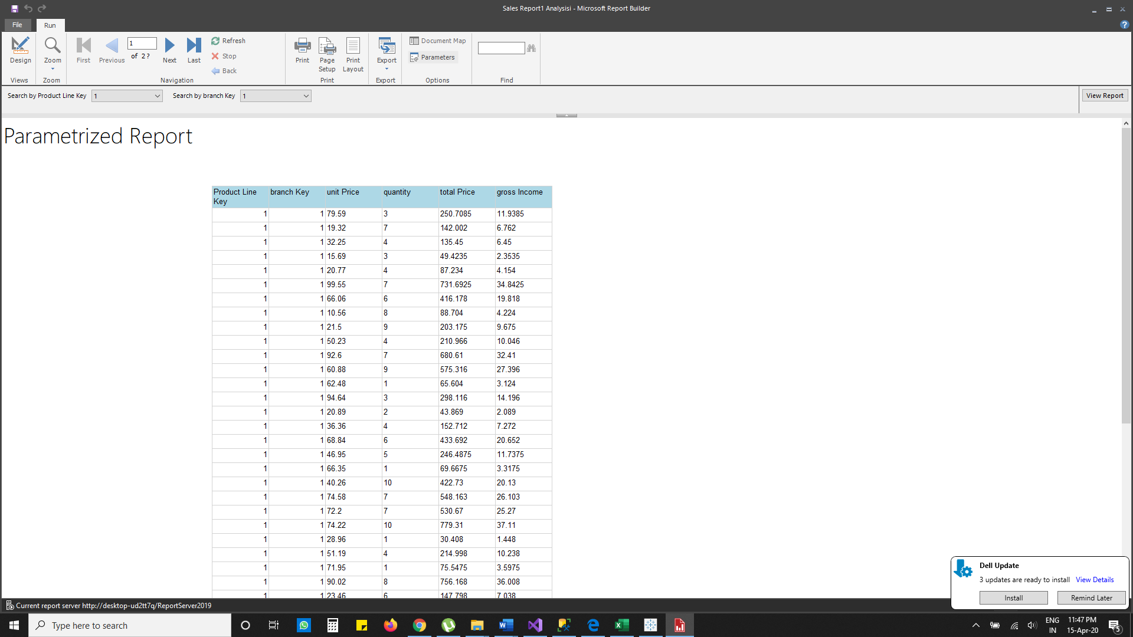
Parameterized Report: All the Products sold in particular branch

Slide 11
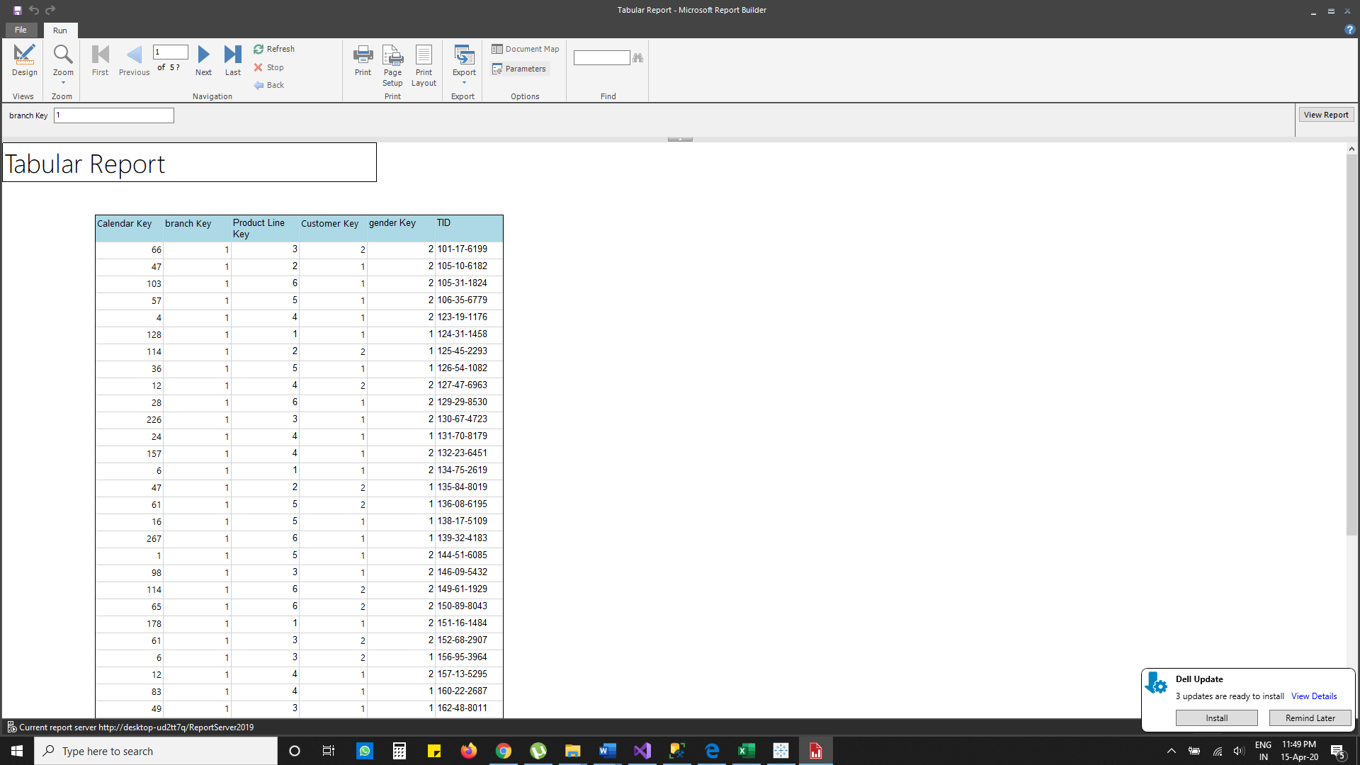
Tabular Report: No. of products sold and which gender buys more

Slide 12
Visualization
Graphical representation of data
It helps us to grasp difficult concepts easier than analyzing it in the form of .csv or other file formats.
We use Tableau for the purpose of generating visualizations
We have generated four plots of different dimension and measures of the data

Slide 13
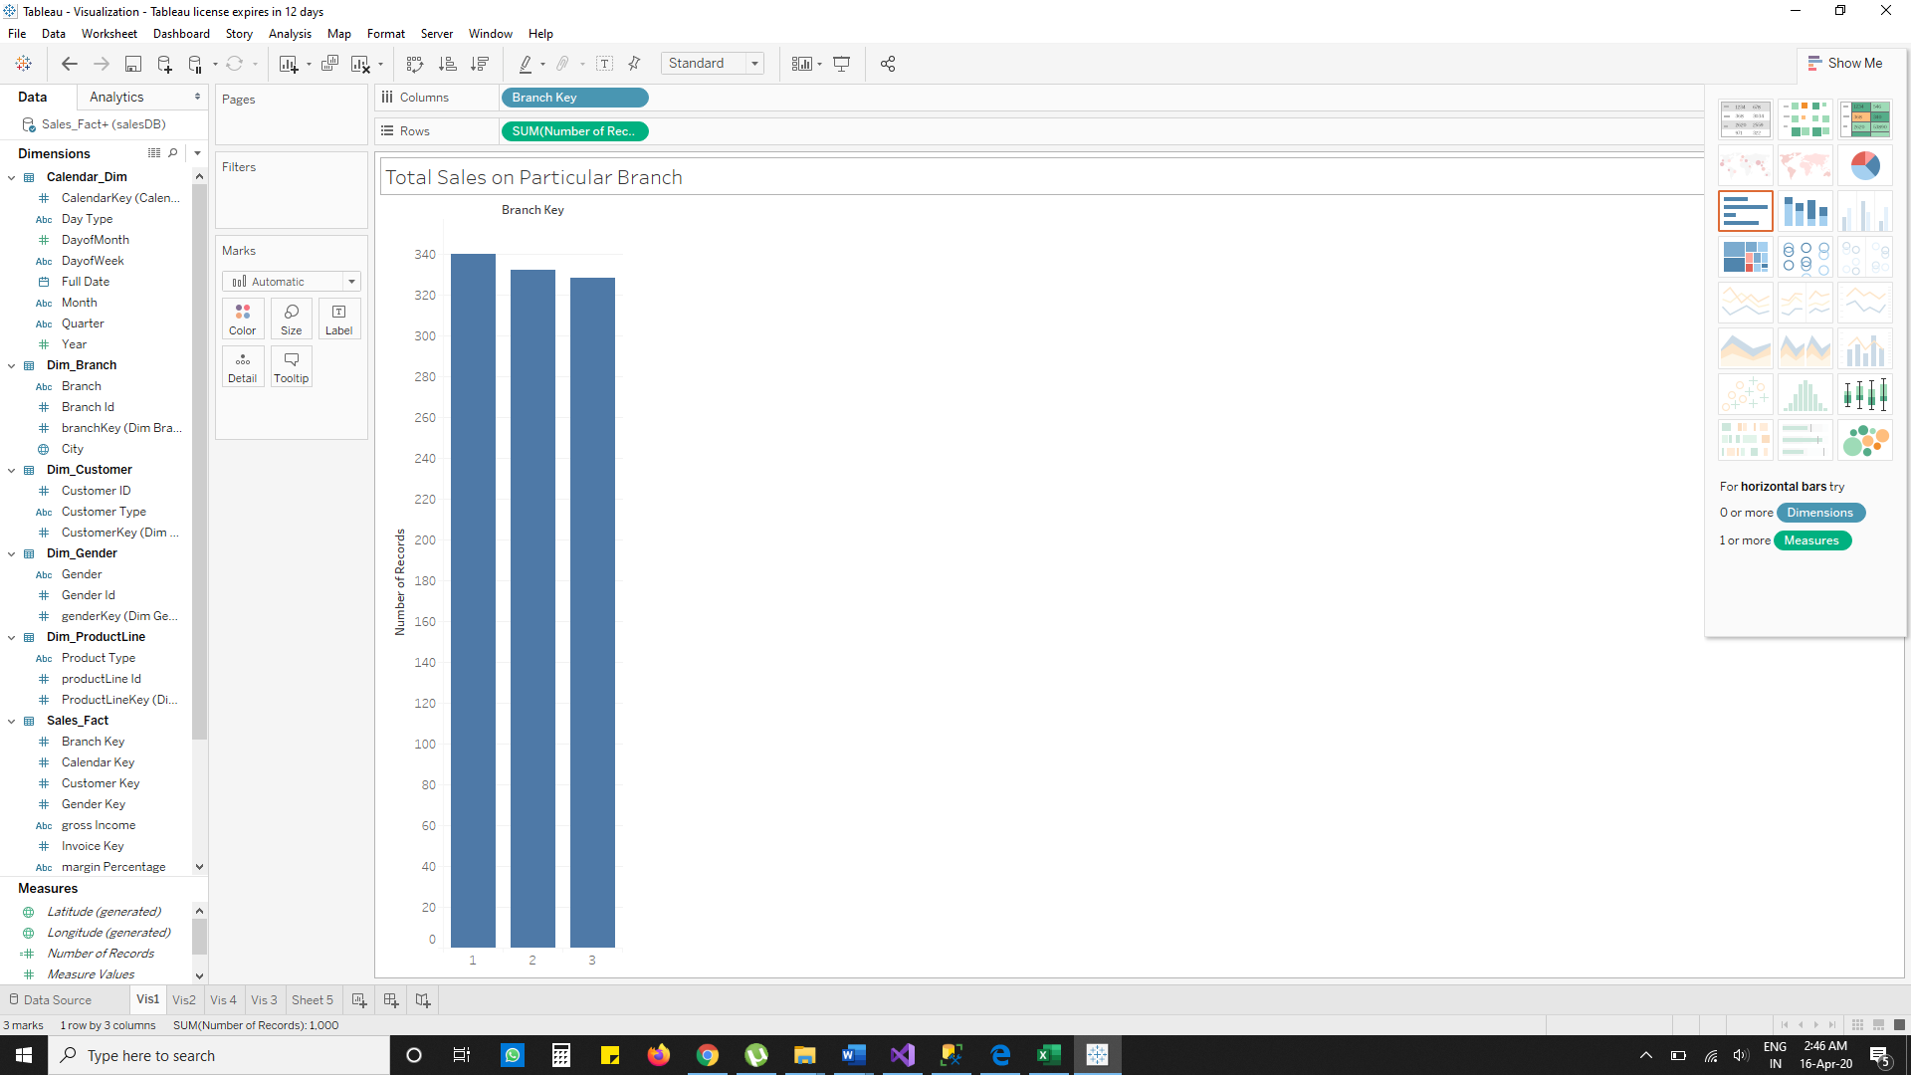
Visualization : Total sales on a particular branch

Slide 14
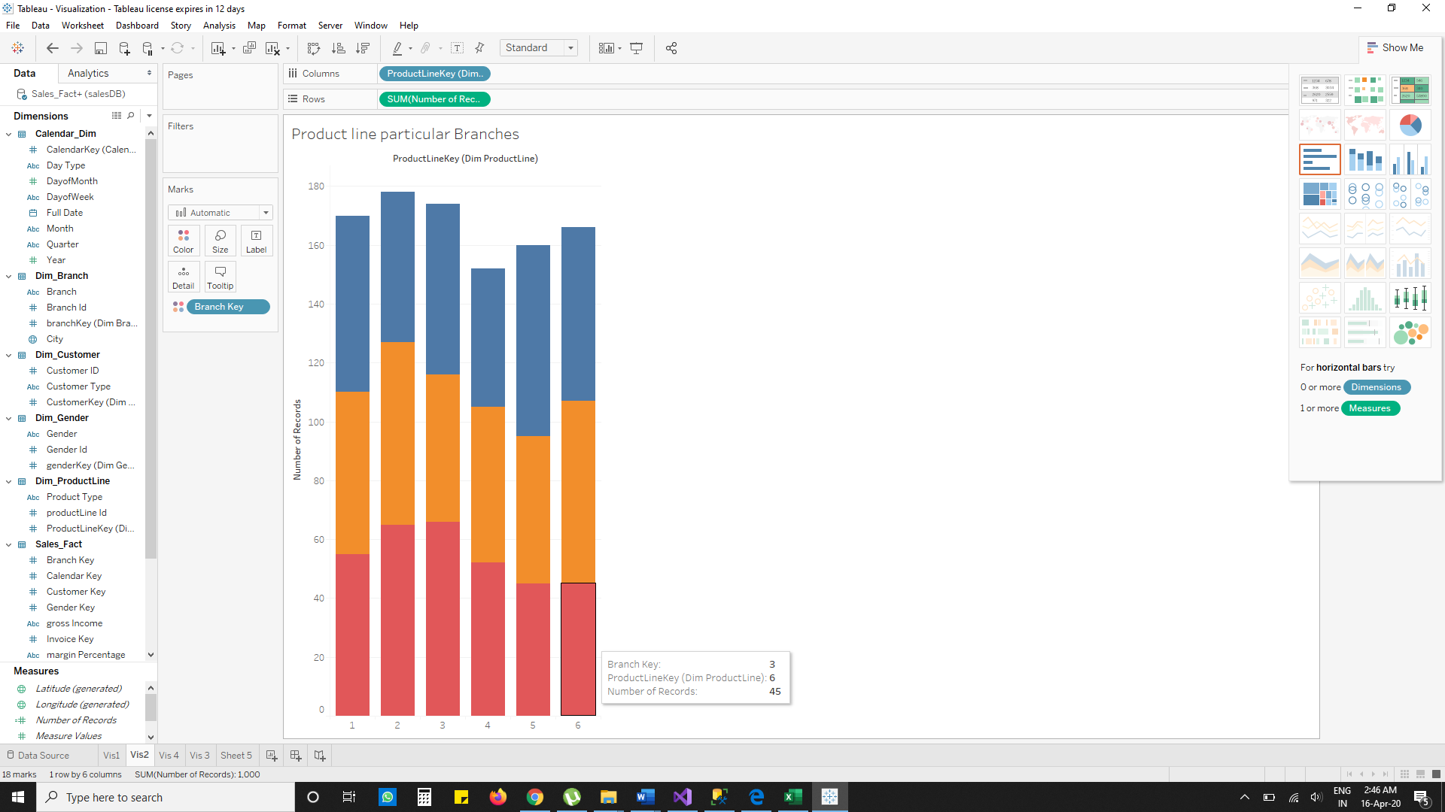
Visualization : Product line particular branches

Slide 15
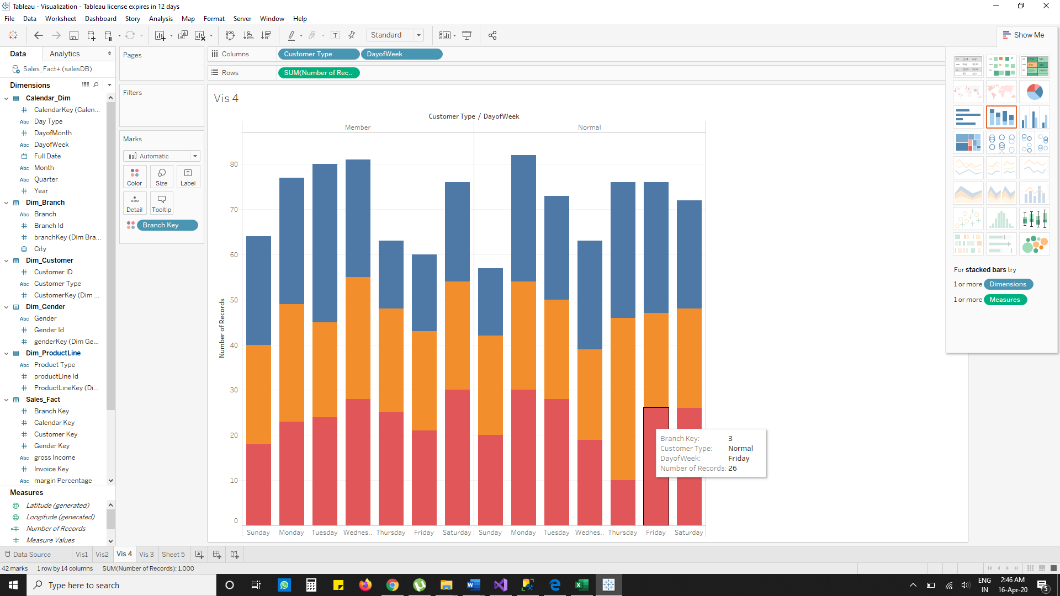
Visualization : Customer type by Day of week

Slide 16
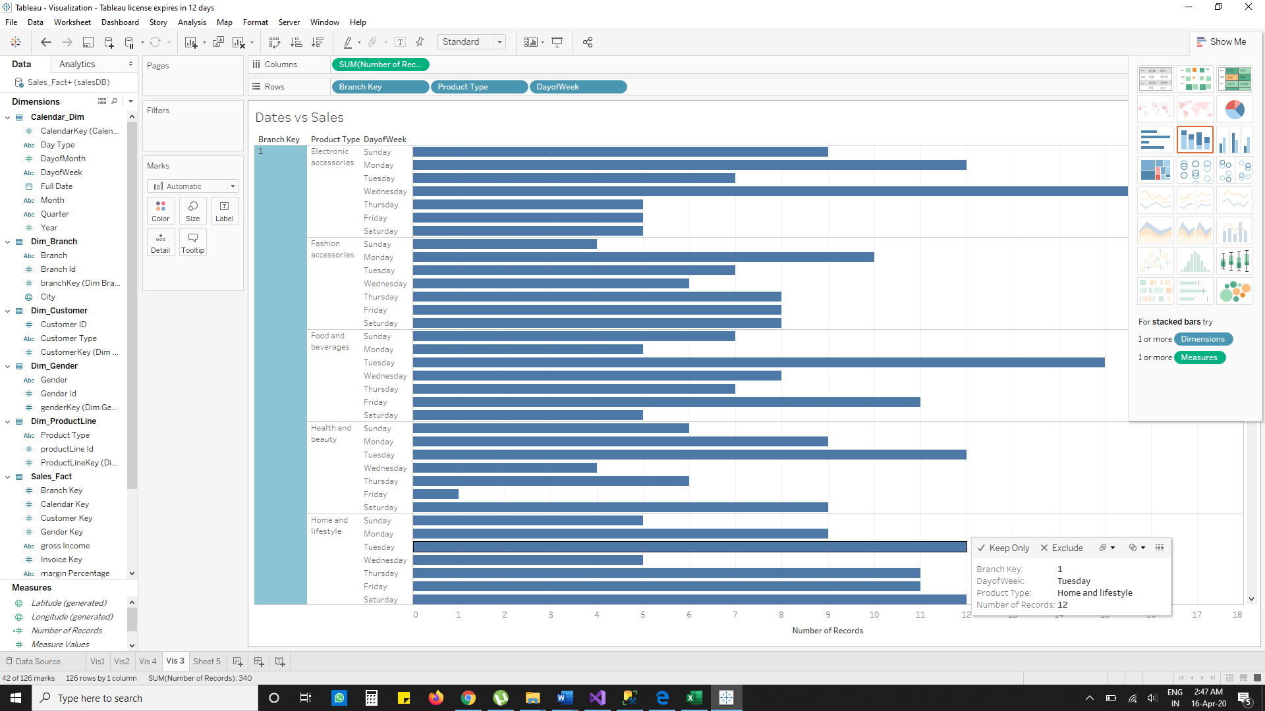
Visualization : Dates vs Sales

Slide 17
Graph Database
We are using Neo4j for the purpose of Graph Databases.
Steps in creating a graph
Import the data file
Create the Nodes
Create Relationships
We are using CQL (cypher query language) in order to create Neo4j Graph Database.

Slide 18
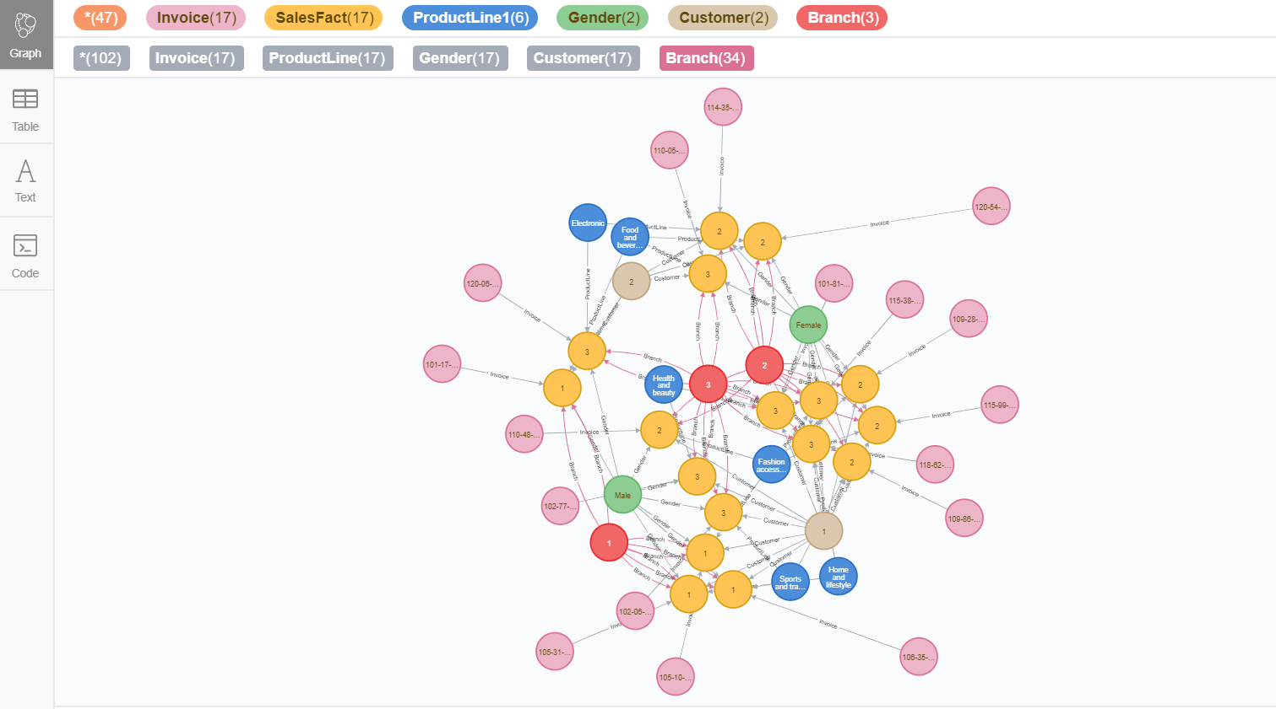
Graph Database: Neo4j Schema

Slide 19
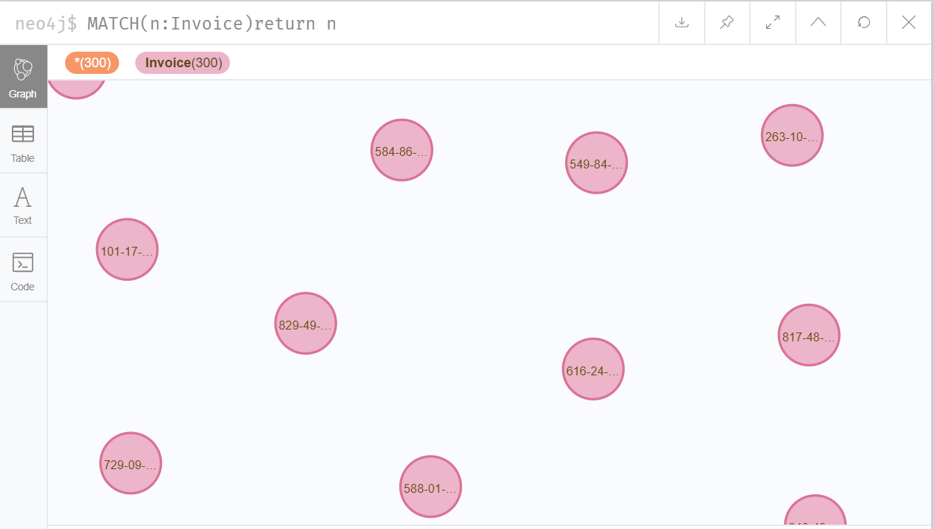
Graph Database: Neo4j
Sample Query
LOAD CSV WITH HEADERS FROM "file:///Invoice.csv" as row CREATE (i:Invoice) SET i = row RETURN i
CREATE CONSTRAINT ON(i:Invoice) ASSERT i.invoiceKey IS UNIQUE
MATCH(a:Branch),(f:SalesFact) WHERE a.branchKey = f.branchKey CREATE (a)-[r:Branch]->(f) RETURN a,f,r
MATCH(a:Customer),(f:SalesFact) WHERE a.CustomerKey= f.CustomerKey CREATE (a)-[r:Customer]->(f) RETURN a,f,r

Slide 20
Final insights
From the analysis done we can come to a conclusion that;
The store `A’ is making more no of bills compare to B and C, But the Gross income is low compare to
The average spending of the customer in store A is 54, B is 55, C is 56.aaaa
“Therefore, we can increase the Gross income in Store `A’ by organizing the store and show casing”
In store `B’ the customer rating is low compare to C and A
“By handling the customers in right way, we can increase the customers and Gross Income.”
Count of bills is low in store `C’ compare A and B.
“We can increase the customers by giving some vouchers so that they will come frequently and buy products more than usual. Therefore, the gross income increases.”

Slide 21

THANKS!
Presented by:
Robin Roy - 10544522

